Slide 1
DDUCLUBS
~Nisarg Pipaliya
~ Kevin Sangani

Slide 2
What is DDUCLUBS?
DDUCLUBS Is a website that gathers the information about the clubs @ DDU .
Information Like What?
Like: What are those clubs ?
Working of clubs….
Events organized by the clubs (past and future).

Slide 3
Purpose
So why does we choose this topic?
We chose it because we saw some students
were unaware about the events organized by some clubs.
Or the long list of whatsapp messages which are generally ignored by most of us😜🤣.
So we came up with an idea to provide a platform to connect students and clubs.

Slide 4
Introducing DDUCLUBS

Slide 5
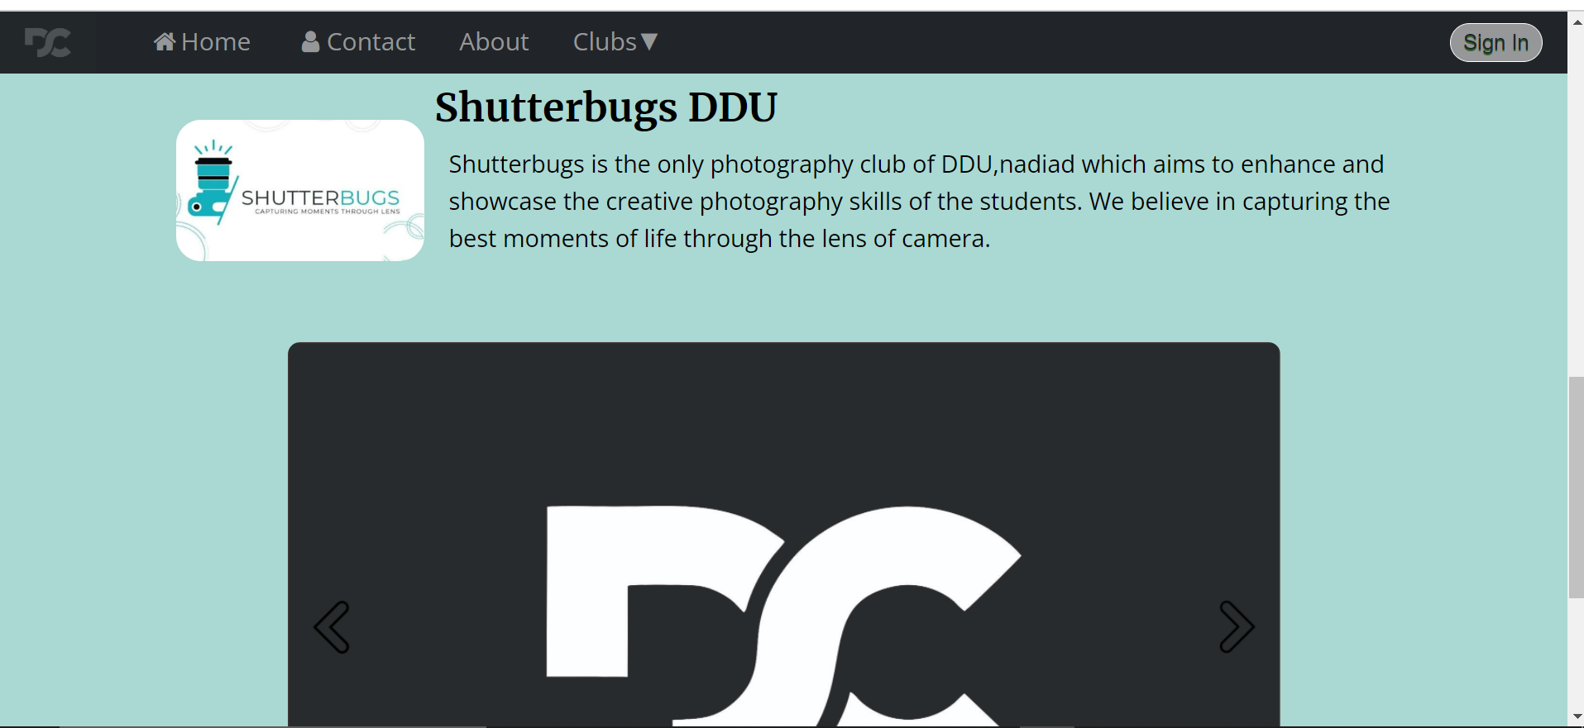

Slide 6
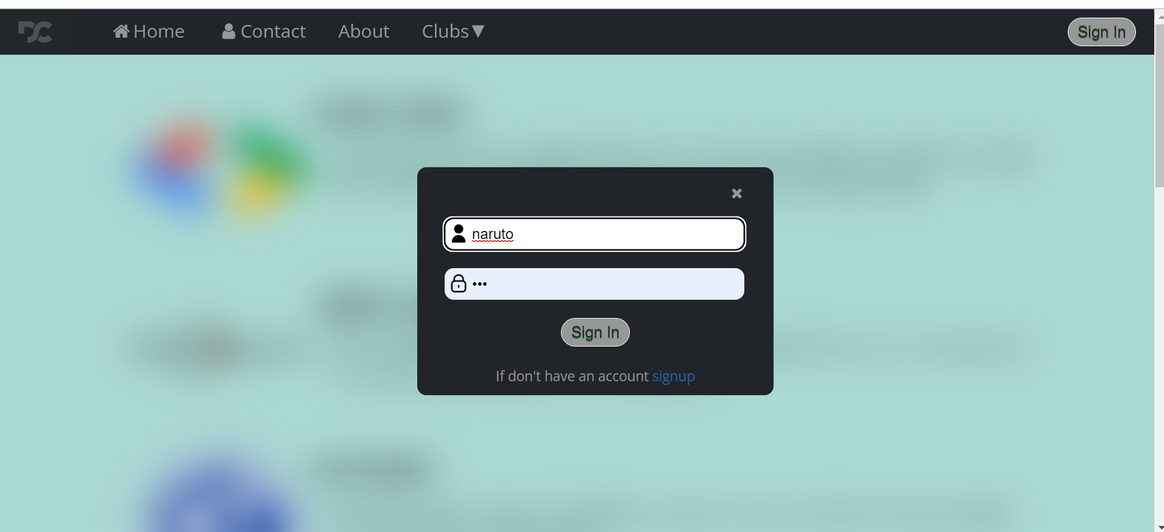

Slide 7
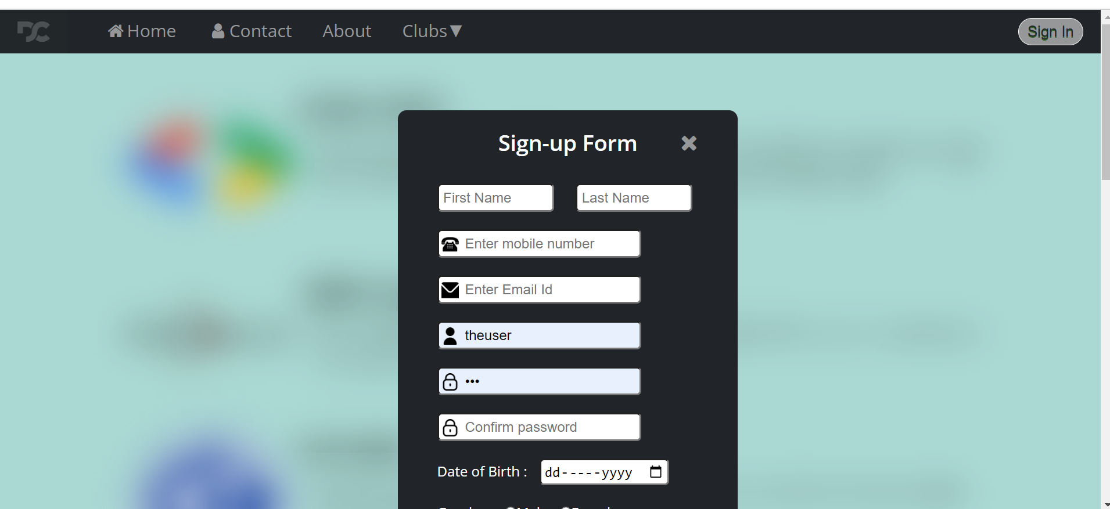

Slide 8
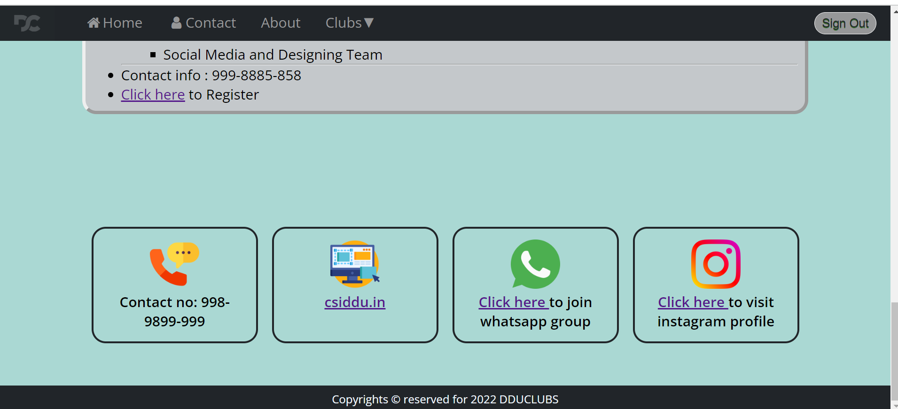

Slide 9
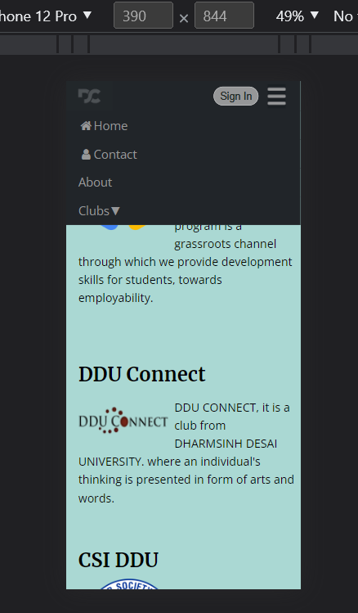
So this is how our website looks when it is opened in mobile.

Slide 10
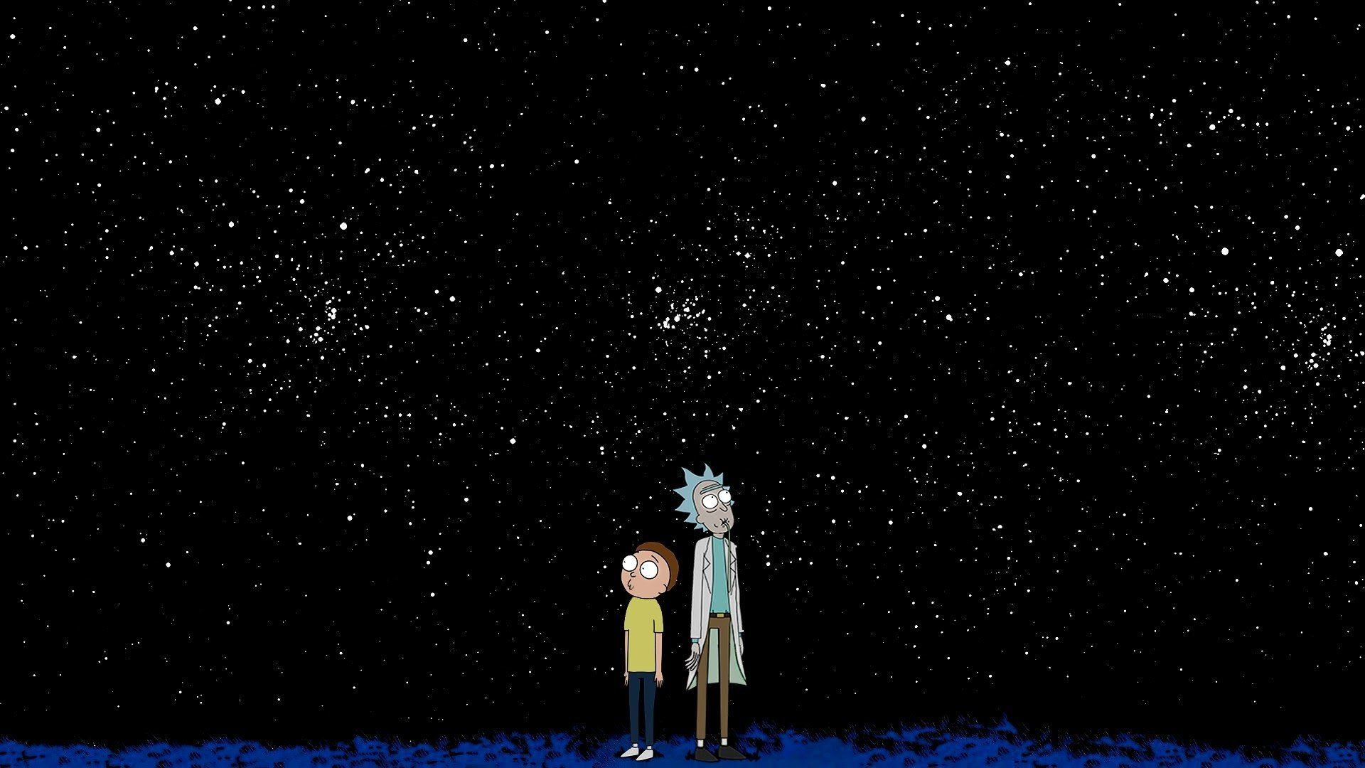
Every body after seeing DDUCLUBS
Awesome

Slide 11
Frontend and Backend
Here front-end of our website consists of HTML,CSS, JAVASCRIPT and PHP.
Where as our back-end comprises of MySql and Yeah you heard right PHP which is generally referred as “DEAD LANG”(BAD JOKE)...😅😅

Slide 12
Benefits
From our website you can get information about the clubs you are interested in.
Can register for the upcoming events organized by any of the club.
Get the details when a club is ready for recruitment.

Slide 13
Limitations
It was not practically possible for us right now to keep record of each and every event being organized.
we are unable to send in-person notifications to the each and every participant.

Slide 14
Future Enhancements
We would like to expand our abilities to handle the data that is being generated .
And would like to add the feature of personalized notification.
Currently website comprises of the information about 5 clubs. Would love to add more groups and much more.

Slide 15
Reference
Logo of respective clubs – From club members.
https://csiddu.in/
https://dduconnect.in/
https://www.dscddu.com/
https://www.linkedin.com/company/shutterbugs-ddu/about/
https://www.linkedin.com/company/readers-community-ddu/about/
Google-fonts : https://fonts.google.com/
Icons : google.

Slide 16
PROJECT INFO
Submitted To –
Prof. Fatema Vohra.
Submitted by –
Nisarg Pipaliya.
Kevin Sangani.
Department
Information Technology.

Slide 17
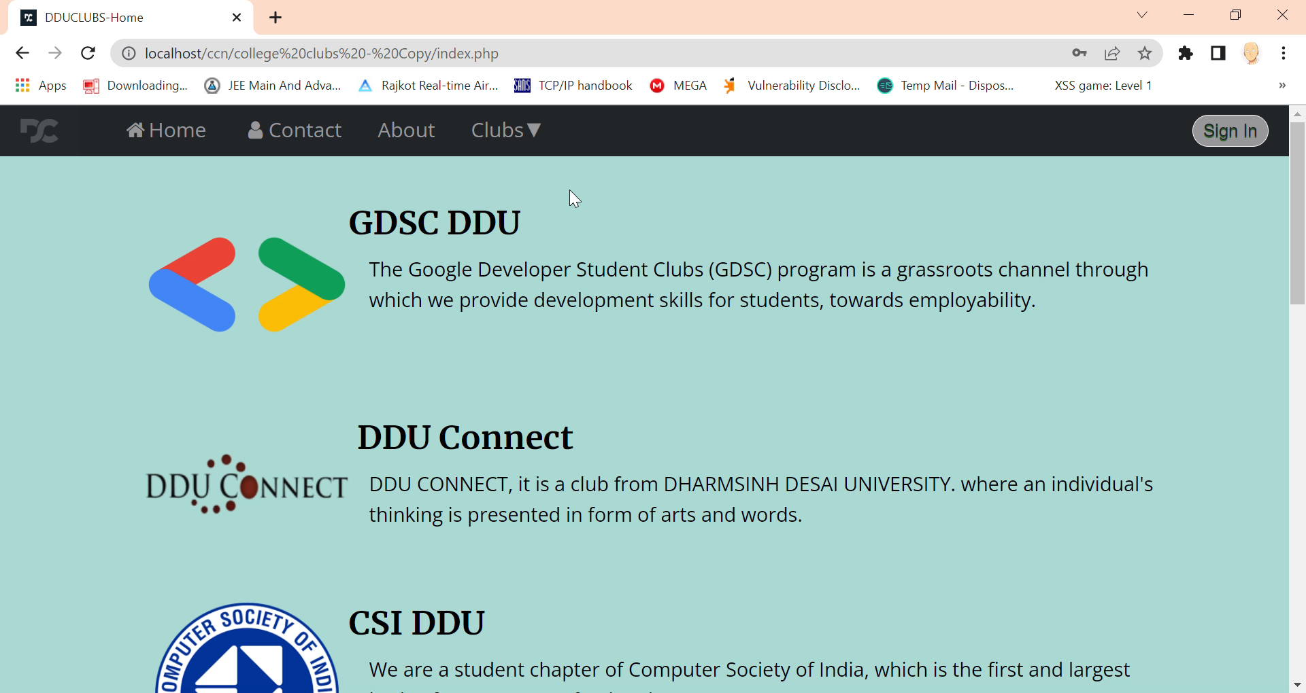

Slide 18
THANKYOU!

Slide 19
Reviews given by madam
Positive:
Animation with sound is good.
Content to the point.
Improvements :
Kevin needs to improve language and presentation skills.
Justify fonts.(done in present ppt).

